Slide 1

Bangladesh Open University
School of Science & Technology
B.Sc in Computer Science & Engineering
Submitted By : | Submitted To :
Name : Towkir Ahammed Ridoy Student ID : 19-052-801-009 Course Title : Human Computer Interaction Course Code : CSE3232 | Mr. Samrat Kumar Dey Lecturer Lecturer,Dept.CSE Bangladesh Open University
Date Of Submission :

Slide 2

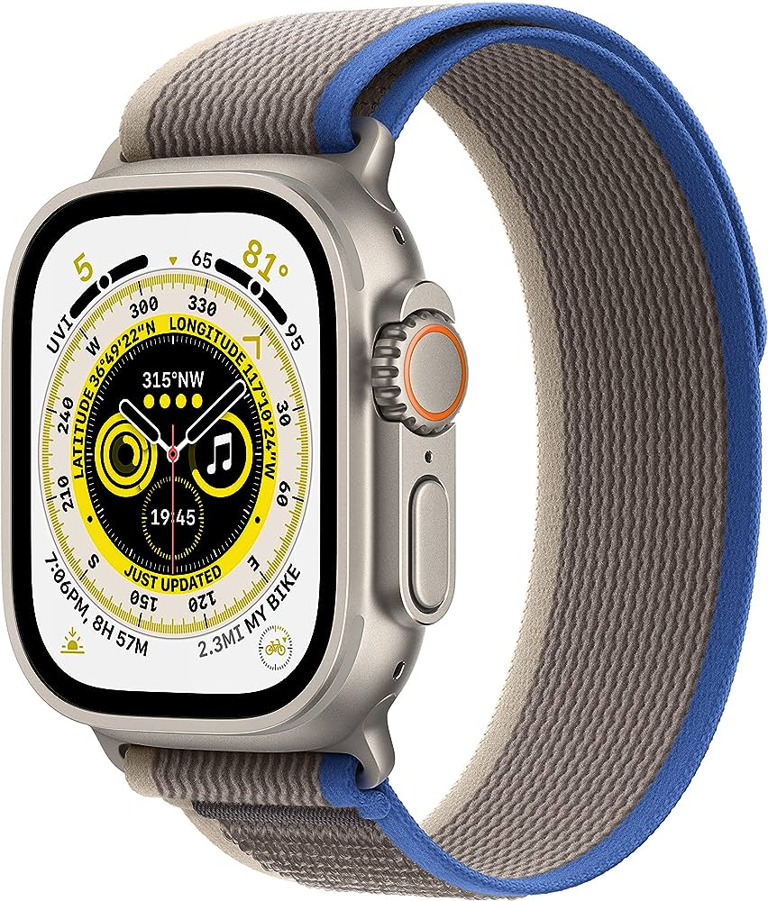




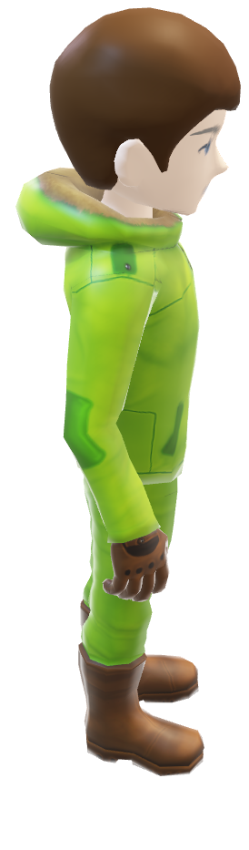
Products
$150
$200
$400
$500
Select Your Products

Slide 3



Choose Color
Green
Blue
Red
Buy Now

Slide 4

Purchases Completed

